Slide 1

COURSE ORIENTATION
First Semester, AY 2026-2027

Slide 2

Opening Prayer
Lord of light and wisdom. Grant us bright intellect, a sound judgment and retentive memory. Help us to study patiently, orderly and diligently to develop our gifts and make good use of them according to your will; as we commit ourselves to Veritas et Fortitudo, Pro deo et Patria. Amen.

Slide 3
Outline
Introductions
LPU and CLAE
Classroom Policies
Course Description, Course Outcomes, Topic Outline
Course Requirements and Grading System
Setting of Expectations
Academic Calendar

Slide 4
INTRODUCTIONS

Slide 5
INTRODUCTIONS:
Course Instructor
MS. CARLISA A. ANONUEVO
BSE Major in English
Master in Educational Management
Phd in English Language (ongoing-Acad. Req.)
carlisa.anonuevo@lpu.edu.ph
College of Liberal Arts and Education

Slide 6
INTRODUCTIONS:
Students
State your name, course and 2 adjectives that would best describe you.

Slide 7
LPU and CLAE

Slide 8
LPU
VISION
An internationally-accredited University by 2030, dedicated to innovation and excellence in the service of God and country.

Slide 9
LPU
MISSION
Lyceum of the Philippines University, espousing the ideals of Jose P. Laurel, is committed to the following missions:
Provide industry-based knowledge and skills. - INSTRUCTION
Undertake multi-disciplinary research. - RESEARCH
Support community engagement and social responsibility. - COMMUNITY ENGAGEMENT
Establish local and international linkages. - INSTITUTIONAL DEVELOPMENT
Produce sustainability advocates for global action. - SUSTAINABILITY

Slide 10
LPU
CORE VALUES
L - Love of God J - Justice
P - Prudence N – Nationalism P – Pro-environment
U – Unity L – Leadership

Slide 11
CLAE
VISION
CLAE envisions itself as a center of internationally recognized programs in the fields of liberal arts and education programs committed to promoting LPU ideals – Veritas et Fortitudo, Pro Deo et Patria.

Slide 12
CLAE
MISSION
The College of Liberal Arts and Education is committed to the following mission:
Cultivate global skills through industry-integrated education.
Lead transformative SDG-aligned research in education, culture, and society.
Apply learning through community service and socially responsive action.
Enrich holistic development through creative and educational pursuits.

Slide 13
CLASSROOM POLICIES

Slide 14
CLASSROOM POLICIES
Attendance of the students in classes is required and will be monitored every meeting.
Tardy – arrives in class fifteen (15) minutes after the official start of the class period
Absent – arrives in class thirty (30) minutes after the official start of the class period; incur 3 Tardy marks
Failure Due to Absences (FDA) – incurs seven (7) absences + 1 Tardiness (for 1.5 class); 3 + 1 tardy for 3-hr class

Slide 15
CLASSROOM POLICIES
Recite LPU Opening and Closing Prayer.
Use of mobile phones in class is prohibited, unless the task is online.
Bullying, disrespect, and shaming are highly discouraged in class.
Handouts and/or other activities will be provided via Learning Management System (myLPU).
Eating, especially chewing gum, is not allowed in class.
Strictly follow the prescribed uniform per college.

Slide 16
CLASSROOM POLICIES
Practice 6S (Sort, Systematize, Sweep, Sanitize, Self-discipline, Safety) inside and outside the classroom (e.g. erase board, arrange chairs, etc.)
Strictly follow the university’s health protocol.
Cheating and plagiarism in the requirements submitted shall be penalized according to the Student Manual.
Students must exhibit academic integrity at all times.
Any concerns against the course, professor or classmates should be properly addressed to the course instructor for appropriate action.

Slide 17
COURSE DESCRIPTION, COURSE OUTCOMES, TOPIC OUTLINE

Slide 18
COURSE DESCRIPTION
ENGLO1G –PURPOSIVE COMMUNICATION
LITNO1G –LITERATURES OF THE PHILIPPINES
JPLNO1G- JPL:Life and Works

Slide 19
COURSE OUTLINE
Present an outline of the topics to be covered per period (Prelim, Midterm, Finals).
You may also show the syllabus.

Slide 20
COURSE REQUIREMENTS
TEXTBOOK
NOTEBOOK
QUIZ
ACTIVITY/SEATWORK/ASSIGNMENT
ATTENDANCE
MAJOR EXAM
PROJECT

Slide 21
GRADING SYSTEM
Enumerate the course requirements including the Major Exam and Creative Academic Performance (CAP) which includes the quizzes, participation, activities, etc.

Slide 22
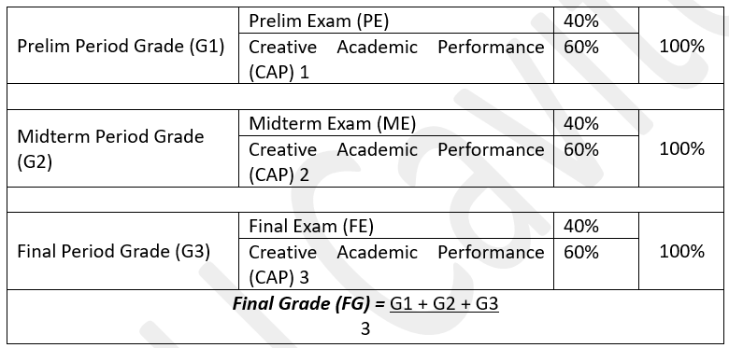
GRADING SYSTEM

Slide 23
REFERENCES
PURPOSIVE COMMUNICATION BOOK
LITERATURES OF THE PHILPPINES BOOK

Slide 24
SETTING OF EXPECTATIONS

Slide 25
SETTING OF EXPECTATIONS
Write your expectations to the following:
Course (Subject)
Classmates
Instructor

Slide 26
ACADEMIC CALENDAR

Slide 27
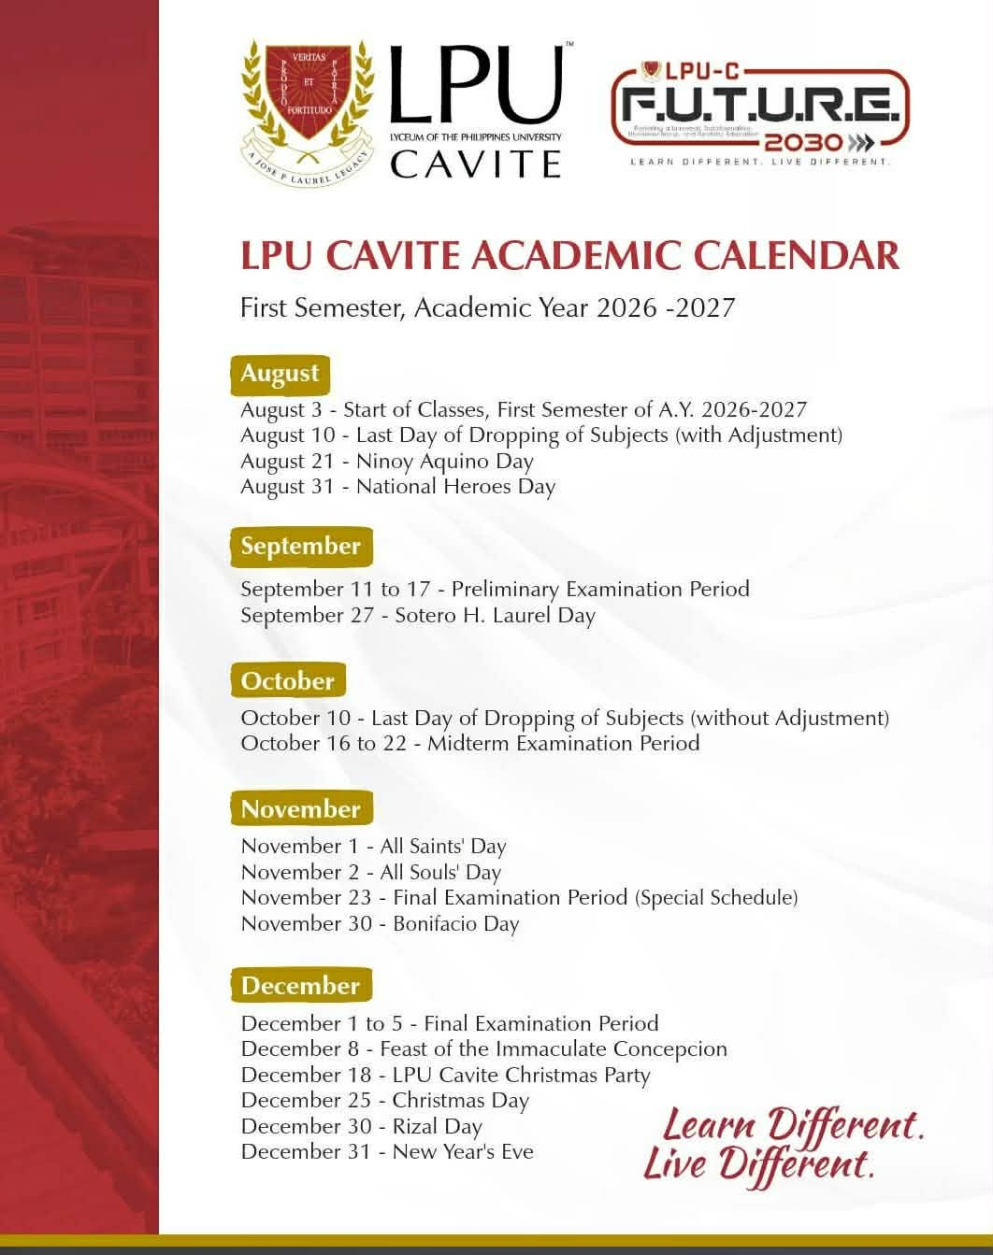
ACADEMIC CALENDAR

Slide 28
Closing Prayer
Lord, thank you for giving us the opportunity to learn and the capacity to understand. Let our knowledge be of service not only for the attainments of our goals but also for the benefit of others.

